Slide 1

BCA Ist Semester
PROBLEM SOLVING USING COMPUTER
Course Code: BCAC 0018
Presented by:
Mr. SANTOSH KUMAR SWARNKAR
Dept. Of CEA
GLA University, Mathura

Slide 2


OBJECTIVES:
TO UNDERSTAND WHAT IS DATA
TO UNDERSTAND WHAT IS INFORMATION TO DIFFERENTIATE BETWEEN DATA AND
INFORMATION

Slide 3





DATA MEANS RAW FACTS AND FIGURES
INFORMATION IS THE RESULT OF PROCESSING

Slide 4




WHAT IS DATA
Facts, statistics used for reference or analysis.
Numbers, characters, symbols, images etc., which can be processed by a computer.
Data must be interpreted, by a human or machine, to derive meaning
So data is meaningless

Slide 5


DATA EXAMPLES
Yes, Yes, No, Yes, No, Yes, No, Yes 42, 63, 96, 74, 56, 86
111192, 111234
None of the above data sets have any meaning until they are given a CONTEXT and PROCESSED into a useable form

Slide 6


DATA CAN TAKE MANY FORMS
ALPHANUMERIC DATA (COMBINATION OF NUMBERS AND LETTERS)
TEXT DATA (SENTENCES & PARAGRAPHS USED IN WRITTEN COMMUNICATION)
IMAGE DATA (GRAPHICS, SHAPES, FIGURES ETC) AUDIO (HUMAN VOICE & OTHER SOUNDS)

Slide 7


WHAT IS INFORMATION
Data that has been processed within a context to give it meaning.
"Information is data that has been processed”
"Information is interpreted data" Information is meaningful

Slide 8

Data need to be turned into meaningful information and presented in its most useful format
For example: What does the number 29061996 mean?
Is it:
  A birthday? (29th June 1996)
  A bank account number?
  A club membership number?
  A telephone number?
Without processing or more information this data is meaningless.

Slide 9
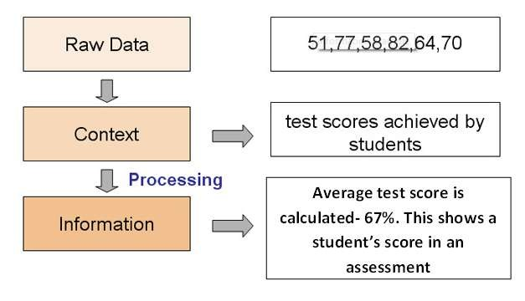
EXAMPLE 1

Slide 10

EXAMPLE 2
The colour red is data as it has no meaning.
What information we attach to the red colour is information
For example:
  On a traffic light it means STOP.
  In a football match a red card means that the player has been suspended.
  In certain places the red colour may mean a danger zone.

Slide 11







Process can be: Manipulation of data. E.g. arithmetic operations, comparing, sorting, searching
Data is meaningless
Information is meaningful
INPUT DATA
DATA IS PROCESSED
OUTPUT INFORMATION
DATA
Is put in
USING INPUT DEVICES
e.g. KEYBOARD
INFORMATION
Is produced
ON OUTPUT DEVICES
e.g. MONITOR

Slide 12

IN SIMPLE TERMS WE CAN SAY THAT:
DATA IS RAW FACTS AND FIGURES & DATA IS MEANINGLESS
WHILE
INFORMATION IS DATA THAT HAS BEEN PROCESSED INFORMATION IS MEANINGFUL

Slide 13
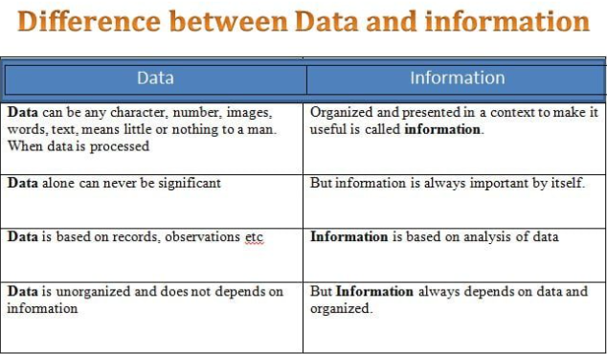

Slide 14

QUESTION 1
Choose between data or information
 30,52,68,25,36,24 .
Stop signal from a traffic light_ .
 ☺♣♠•◘☻♥♦ .
A yellow card in a football match .

